Slide 1


Email to Artificial Intelligence Final Phase Pitch Deck Scott Burdick Michael Celesti Daniel Chong John Garrett
The Problem
It is difficult to organize, share, and track information
Value Proposition
AI data processing emails for user and team organization
Provides file sharing, and team analytics
Target market
Enterprise Licenses
Free use for Universities, Households
Missed deadlines, time wasted searching through old emails, and anxiety

Slide 2

It is difficult to organize, share, and track important information in the connected digital age
Disorganized items spread across emails
Time wasting, manually arranging items in appropriate locations: email to Sharepoint to Teams to Shared Folders to Calendars
Emails today arrive without any priority power users are overwhelmed by daily email resulting in lost productivity and lost messaging
Keeping knowledge – even when faced with changes like new workers, new projects, and new commitments
Losing track of important items

Slide 3

Using A.I. and Distributed Computing, shared data can be constantly organized to meet your mission needs
Allows operator fail-safe interactions - "trust the code, not the user"
Automatically version controls, organizes, and catches submission duplications and user access requests to measure popularity
Displays important information in an organized and crowd-sourced way for all users
Available from all devices because email-based

Slide 4
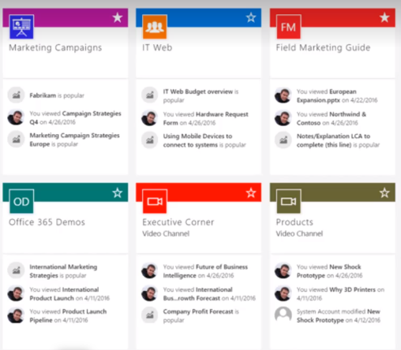
Key Feature #1 A.I. Sorting Schema
Content Based sorting
Using NLP and AI algorithms, our product can sort emails into their respective projects
Learns Trends
The algorithms learn over time based on user changes
Only shows messages to those with proper permissions
Doesn't provide visibility to those who didn't receive email unless a manual override occurs

Slide 5
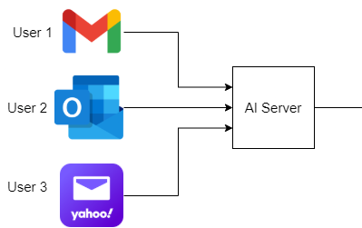
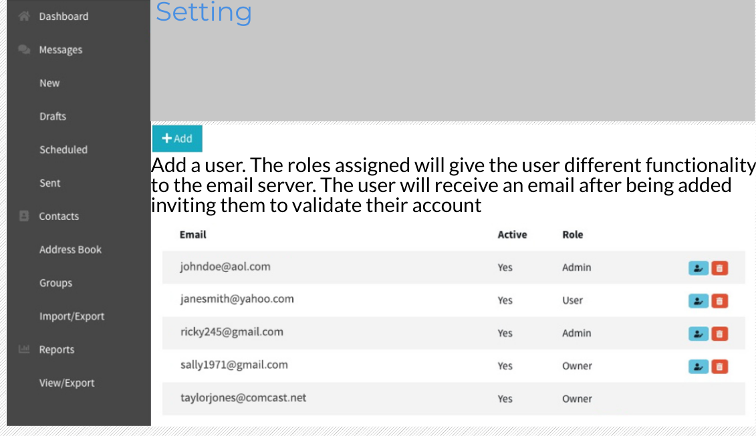
Key Feature #2 Collaboration Functionality
Multi-users
Accessible for many users
Headquarter of shared knowledge
Multi-email providers
Convenient for a variety of email users

Slide 6
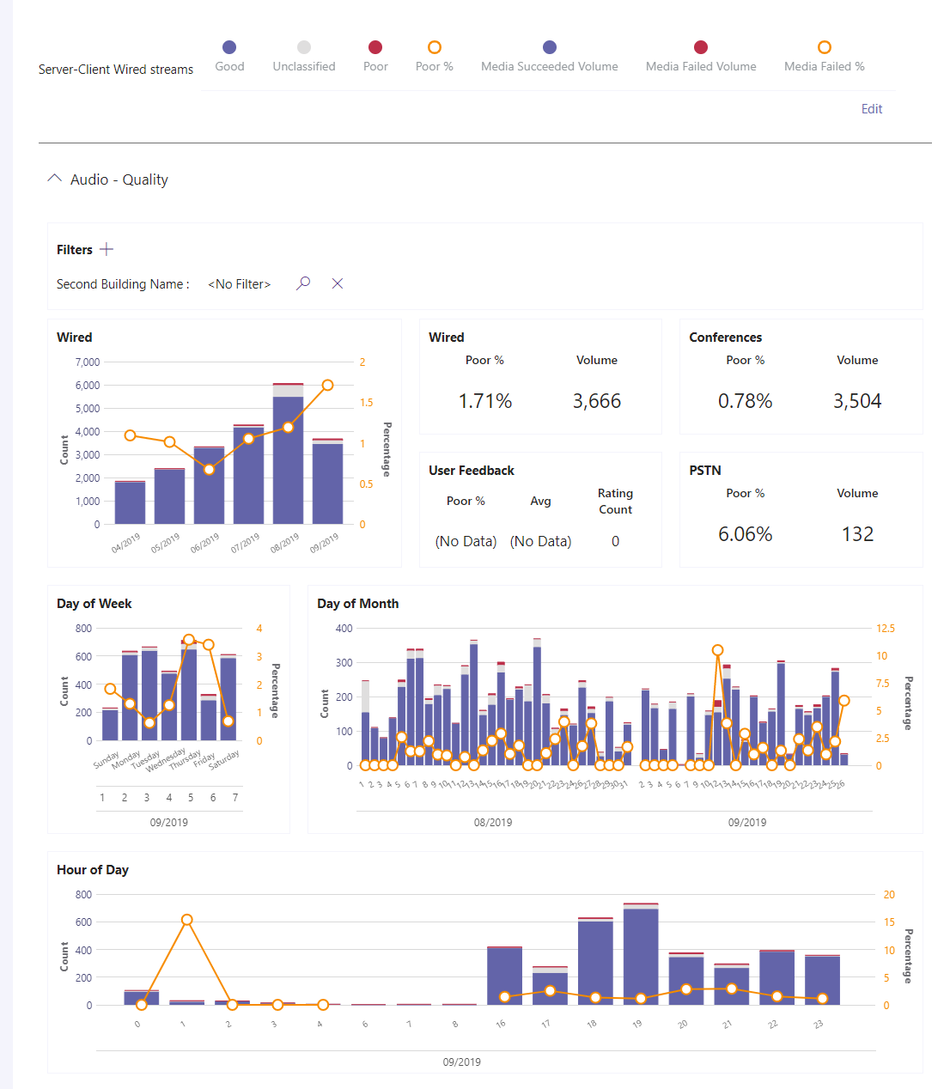
Key Feature #3 Data Analytics For Organizations
Data Analytics to help the team evaluate their communication effectiveness & tool utilization
Metrics include (separated by project):
Average Email turnover time
Auto-populated Deadline tracking
Number of daily/weekly/monthly client engagements
File sharing summary
Estimated time save for organizations

Slide 7
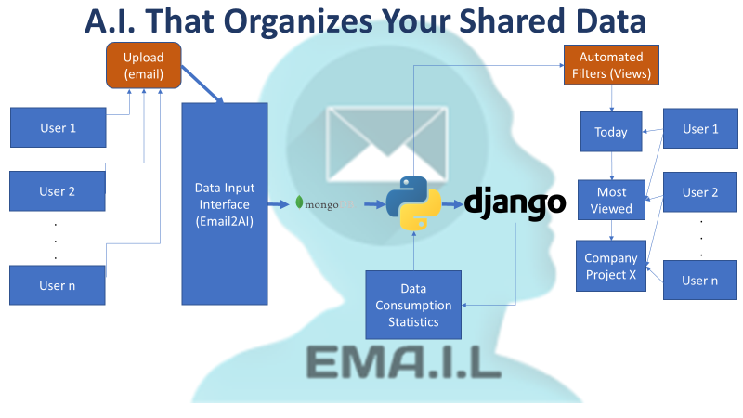
Current Status

Slide 8
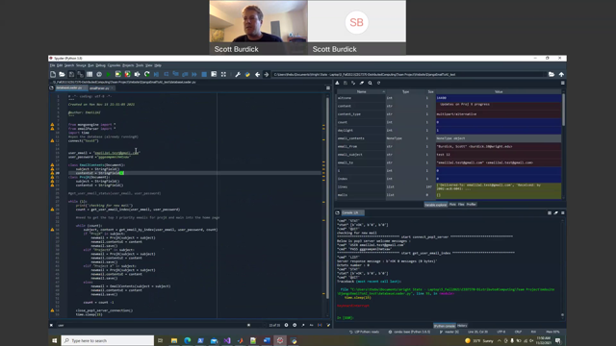
Demo

Slide 9
Business Model
Free for households – this will spread the product so businesses will consider using it
Free for Universities – mass adoption of the software can be driven by the educated workforce
Licensing – yearly cost to license the product based on user base (per user). It becomes more valuable to the company over time, as data is fed into the model which will give us pricing advantage.

Slide 10




Team Contributions
Michael Celesti
3 Years Software Development Experience
And Operations Analysis
Constructive Simulation Analyst
A.I. algorithms and Data Analytics
Scott Burdick
20 Yrs Software Development Experience
Certified Secure Software Professional
DEVSECOPS team lead
Tools and assets acquisition,
Product Incubator
Did everything.
Daniel Chong
3 Years Cyber Security Researcher
Frontend Development
Jonathan Garrett
Year of Machine Learning Researcher+
Public Relations

Slide 11
What do we need to make this happen?
Design and Development: Flesh out initial product features and required resources
Email processing Done!
Email Sorting Algorithms (WIP)
Security (WIP)
Front end UI Done!
Database development Done!
AI / Web Scripting Done!
Data Analytics (WIP)
(Future) Sharepoint import
(Future) Teams import
Technical Validation: Each instance of the product acts as a standalone ecosystem
Initial trials at local small businesses or teams for product development ideas and additions
Partner with local schools (WSU, UD) to test and expand capabilities
Scale up
Utilize local resources like the Dayton Development Coalition
Product awareness/marketing

